Slide 1
Situation Review of the EaP region 2017
Cyber Security and e-Democracy
Kristina Reinsalu, PhD
e-Democracy Programme Director
e-Governance Academy

Slide 2
e-Democracy
One-way G2C communication
Two-way interaction between governments, NGOs and citizens
Active participation, direct contribution by NGOs and citizens

Slide 3
Aim of the review
A structured overview about the recent developments in the area of e-democracy in the EaP region.
Policy recommendations for future development.

Slide 4
Methodology
Focus on central level e-democracy
Qualitative methodology (document analysis, questionnaires and semi-structured interviews)
Questionnaire answered by local partner and validated by interviews
Study visits to 6 EaP countries April-June 2017
35 interviews, 4 blocks of questions

Slide 5
Research topics
1) e-Readiness - national surveys conducted in the EaP countries
2) Strategic and legal frameworks – main startegies and action plans
3) Institutions and actors – governmental institutions and stakeholders involved
4) e-Democracy showcases – most prominent implementations of e-democracy in the EaP countries

Slide 6
Findings

Slide 7
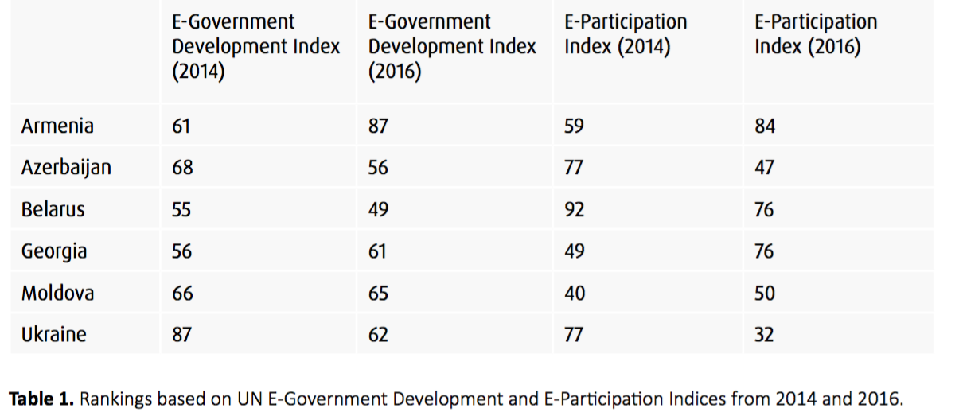
e-Readiness

Slide 8
Strategic
and legal frameworks

Slide 9
Abundance of strategies and action plans
Armenia, Georgia: Anti-Corruption Strategies and Implementation Action Plans
Georgia, Moldova: Public Administration Reform Roadmap 2020; E-Georgia Strategy; Digital Moldova 2020
Ukraine: Law on Access to Public Information, Law on the Open Use of Public Funds; Concept Paper for Development of e-Democracy
Azerbaijan: Law on Public Participation
Georgia, Moldova, Ukraine: Freedom of Information and Law on Access to Information
Moldova: Law on Transparency in decision-making process, Government Decree on Open Data
OGP national action plans
Low level of enforcement of existing legislation, absence of compliance mechanism
Role of OGP global initiative
Good showcase of drafting policy paper on e-democracy

Slide 10
Institutions
and
actors

Slide 11
Fragmented coordination, unclear division of tasks between different actors/institutions
No responsibility for coordinating civic (e)participation
The area of advocacy is in early stages of development
It is beneficial to bring e-government issues under subordination of higher executive levels
Successful cooperation experience with civil soviety whithin framework of the e-democracy coalition

Slide 12
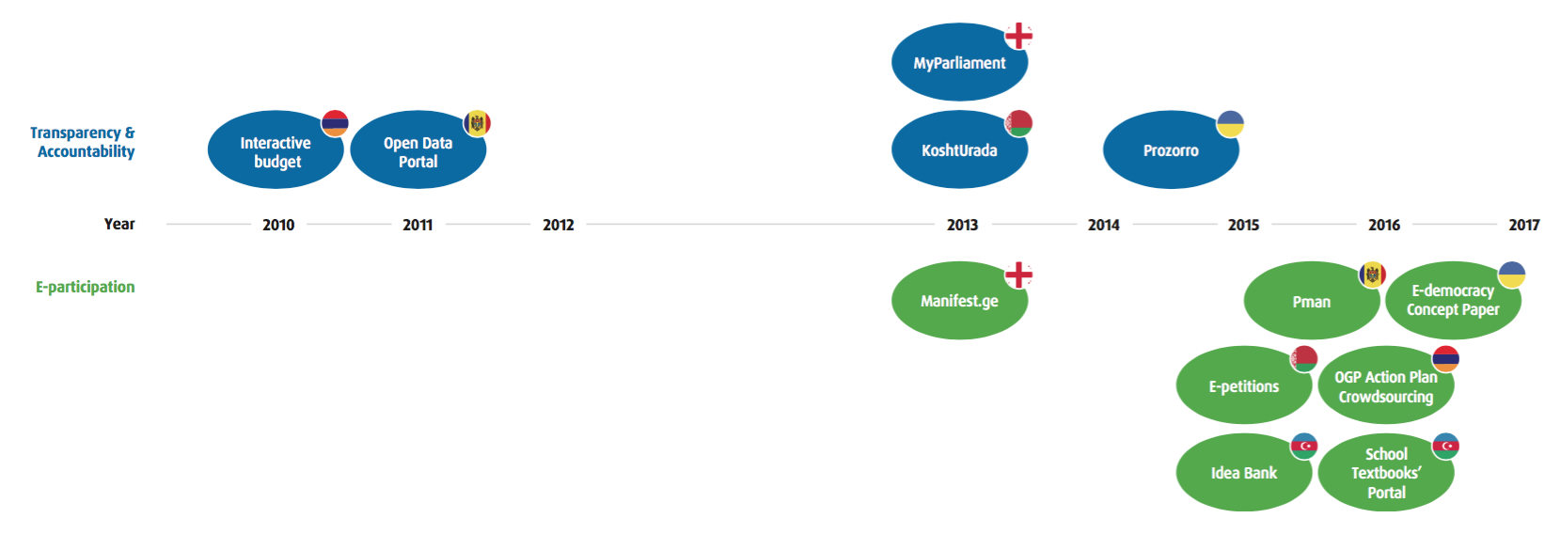
e-Democracy Showcases

Slide 13
Conclusions
OGP´s role
Multi-stakeholders partnerships
Low level of e-democracy literacy and lack of awareness of the benefits of e-democracy tools
Lack of comprehensive national surveys in regards to e-governance development and e-readiness
Local level activism boosts general e-activism
Importance of „offline" activities

Slide 14
Recommendations
Renewal of the legislative framework
Clear coordination and cooperation mechanisms; distribution of responsilities
Coalitions around certain issues
Supporting innovativeness and novel approach of NGOs and rise advocacy skills (analytical, digital) of NGO-s
Systematic monitoring of e-democracy developments, creation of comprehensive overview of e-democracy tools

Slide 15
Thank you, our local partners - Veronica, Dmytro, Lilit, Natallia, Mahammad, Teona -
and all our respondents!

Slide 16
Thank you!
Kristina Reinsalu, Jelizaveta Krenjova
e-Governance Academy
www.ega.ee
Follow us on Twitter and FB eGovAcademy

