Slide 1

Statistics Estonia: Data collection for effective decision-making
Urmet Lee
Director General of Statistics Estonia
24.11.2021
Presentation to the state enterprise Zerde, Kazakhstan and goverment delegation of Kyrgystan

Slide 2

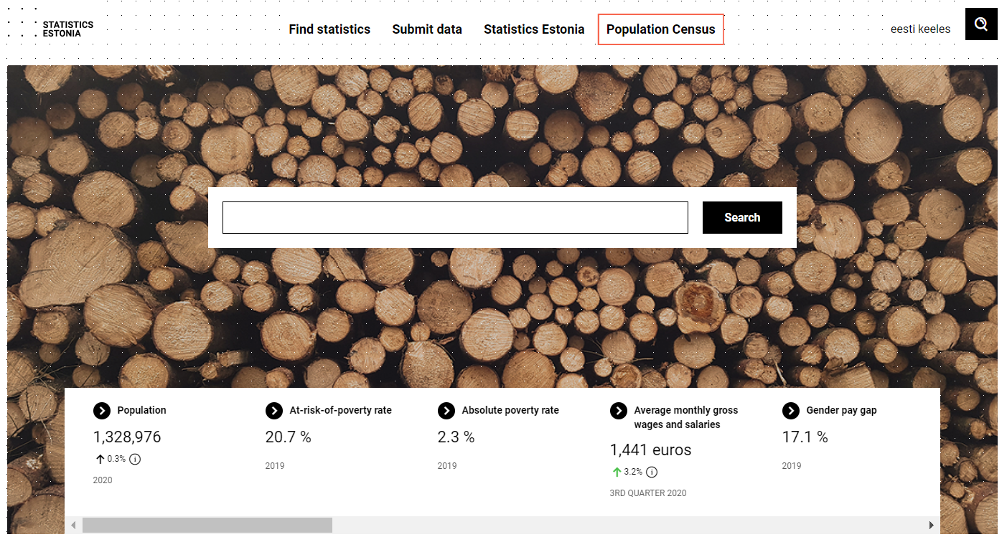
Brief history (1)
1 March 1921 State Statistical Central Bureau established
1922 Statutes of State Statistical Central Bureau
1938 Act on State Statistical Central Bureau
1940‒1992 Statistical Administration of the Estonian S.S.R.
1990 Statistics Act
1997 Official Statistics Act (amended 2010, 2018)
2004 Estonia joins the European Union and Statistics Estonia is part of the European Statistical System

Slide 3
Brief history (2)
2006 electronic data transmission channel eSTAT
2010 Official Statistics Act
2012 Population and Housing Census is carried out to participate in online
2015 Statistics Estonia is awarded the Green Office of the Year award
2017 Statistics Estonia chairs the Council Working Party on Statistics during the Estonian Presidency of the Council of the European Union
2019 Statistics Estonia presents first interactive visualisation applications Foreign trade and the Tree of Truth, measuring important national indicators.
2020 Statistics Estonia publishes interactive tools Wages and salaries and Dashboards,

Slide 4
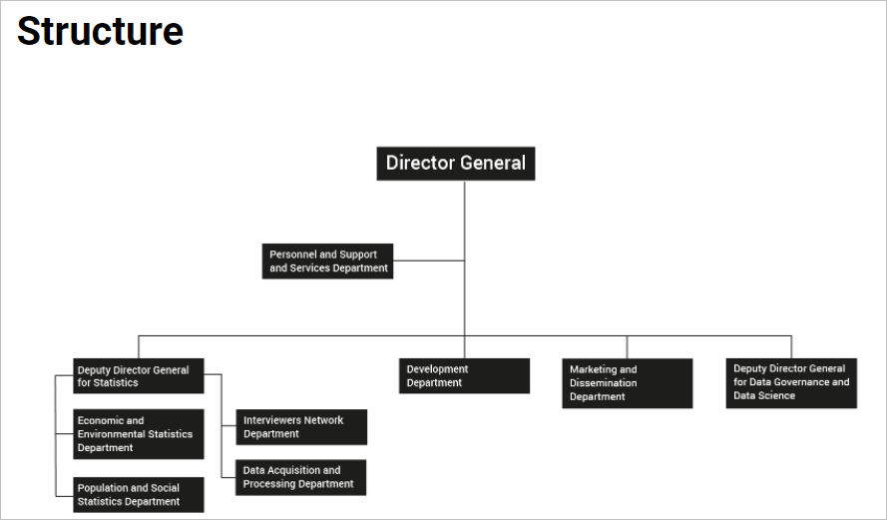

Statistics Estonia (SE)
A state agency in the area of government of the Ministry of Finance
Offices in Tallinn, Tartu and Viljandi
373 active employees
81.77% women, 18.23% men
Average age: 48.71 years
Average length of service: 9y 10m 4d
Data as at 11/2020. Structure from 10/2021

Slide 5
Our mission
The purpose of official statistics is to reflect the situation of and changes in the society and to provide the society with information relevant to the demographic, social, economic and environmental development, including for preparing development plans and forecasts, developing different policies, conducting scientific and applied research, and making knowledge-based decisions.
Official Statistics Act § 1.2

Slide 6
European Statistics Code of Practice
The European Statistics Code of Practice is based on 15 principles covering the institutional environment, the statistical production processes and the output of statistics.
The quality criteria for European Statistics are defined in the European Statistical Law.
Statistical authorities, comprising the Commission (Eurostat), national statistical institutes and other national authorities responsible for the development, production and dissemination of European statistics, commit themselves to adhere to the Code.
All EU Member States, the EFTA/EEA countries and Eurostat are subject to a Peer Review.

Slide 7
Strategy map
MISSION
Our mission is to provide reliable and objective information about Estonia.
VISION
Statistics Estonia as a statistical office (data agency) will be the most effective and innovative producer of reliable and client-friendly statistics in Europe by 2022.
GOALS
E1: Client-friendly and trustworty
E2: Timeliness
E3: Effective
MAIN
ACTIVITIES
1. Execution of statistical programme
2. Knowledge sharing
4. Data service
3. Data governance
SUPPORTING ACTIVITIES
5. Building partnerships
6. Digitalisation of production
7. Highly motivated competent staff

Slide 8
Goals for 2022
Reliable information
Implement the official statistical programme, incl. Census 2021, indicators of sustainable development and other international and development plan indicators in the domains of population, social life, environment and economy.
User-friendly information
Visualise and offer important information in as personalised format as possible, through governance dashboards and development of statistical literacy, thereby contributing to knowledge-based decisions.
Low administrative burden
Realise automatic data collection in Reporting 3.0, adopt additional data sources for big data and administrative data and ensure the implementation of the once-only principle.
Rapid real-time data mining
Establish and offer real-time data mining related to important social phenomena and for quick and relevant decision-making, establish a basis for twice-used data use.

Slide 9
GSBPM and statistical programme
Collecting client needs
Data collection & processing
Data analysis
Communi-cation
Evaluation
Design of production system
Draft of statistical programme
Government approval for 5-year plan
GSBPM
SE’s additional tasks:
Data governance
Maintaining registers
Contract services offered:
Data analysis
Data capture and surveys
Data sharing (as service)
Anonymisation
Virtualisation

Slide 10







e-Estonia timeline
e-cabinet
e-school
e-tax
board
digital
signature
m-parking
X-Road®
id-card
eesti.ee
id bus
ticket
2000
2001
2002
2003
2004
Notes:
Of course, digitalisation was not done in a day. It took 5 years from changing legislation to offering the very first online service. And also after that initial breakthrough, creating good digital services and generating acceptance for those services takes time. Still, here is a timeline that describes Estonia’s journey pretty well.
2000 – e-Cabinet - database and scheduler for streamlining governmental decision-making processes.
2000 - Estonia had an online e-Tax Board already in 2000, while many other countries have created similar online versions only in recent years.
2000 – m-Parking - a system that enables drivers to pay for city parking via mobile phone.
2002 – e-ID - digital identification based on the mandatory ID card.
2005 – Estonia was the first country in the world to use i-Voting. Since then, there have already been 9 elections in Estonia where people could cast their vote using i-vote – 30% of Estonians cast their vote via the i-voting system from 128 countries all over the world.

Slide 11






e-Estonia timeline
e-police
system
e-notary
mobile-id
keyless signature infrastructure
i-voting
e-justice
company
registration
portal
e-health
system
e-prescriptions
2005
2006
2007
2008
2010
Notes:
2005 – i-Voting has become one of the most popular services in Estonia and also one of the hallmarks for which Estonia is known abroad. Estonians can vote online in municipal, national and European Parliament elections online using their electronic ID card or alternatively the Mobile-ID SIM card. In the most recent election in 2019, 46.7% of votes were cast online.
2006 – e-Justice – in 2006 the Court Information System (KIS) was launched, offering one information system for all types of court cases: Estonian courts of the 1st and 2nd instance and Supreme Court. KIS enables the registration of court cases, hearings and judgments, automatic allocation of cases to judges, creation of summons, publication of judgments on the official website and collection of metadata.
2007 – Mobile-ID - allows people to use their mobile phone as a form of secure digital ID. Like the ID-card, it can be used to access secure e-services and digitally sign documents, but has the added advantage of not requiring a card reader.
2008 – e-Health - a nationwide system integrating data from Estonia’s healthcare providers.
2010 – e-Prescription - a centralised paperless system for issuing and handling medical prescriptions.

Slide 12




e-Estonia timeline
visualised
business
register
e-service of the Estonian Road Administration
smart grid
ev quick
charging
network
public services green paper
e-residency
e-receipt
2011
2012
2013
2014
2015
Notes:
2013 – Public services green paper - Mapping challenges and solutions for developing state e-services to address the e-state’s current shortcomings and assure its sustainability and future development.
2014 – e-Residency - A borderless digital society for any global citizen to join. The aim of e-Residency is to find new and innovative ways to attract international business and talent to Estonia.

Slide 13

e-Estonia timeline
NIIS
X-Road®
consortium
kick-off: proactive government
AI strategy
50 public sector AI
use cases
data
embassy
crossborder
e-prescription
reporting
3.0
7 invisible services
2017
2018
2019
2020
Notes:
2017 – data embassy in Luxembourg was established. Data Embassy is an extension in the cloud of the Estonian government, which means the state owns server resources outside its territorial boundaries. This is an innovative concept for handling state information, since states usually store their information within their physical boundaries. Data Embassy resources are under Estonian state control. They are secured against cyberattacks or crisis situations with Blockchain technology and are capable of not only providing data backups, but also operating the most critical services.
2019 – AI strategy - We have launched an expert task force, led by the Government Office and the Government CIO. The task force released a report in May 2019 on a national AI strategy on how we will advance the uptake of AI solutions in public sector as well as wider economy.
2019 – Reporting 3.0 - the automatic data collection environment. With enforcement of Reporting 3.0 strategy, Estonia has already managed to improve the quality of data collected by its government statistical organisations; thereby lowering the administrative burden on enterprises with regards to communicating basic information to Statistics Estonia or the Estonian Tax and Customs Board.

Slide 14
X-road
the busiest highway since 2001
X-Road – the free and open-source data exchange layer software
  modular, easy-to-use, secure data exchange solution
  decentralised and distributed network
  expert community of almost a thousand people from over 60 countries
  operational in Azerbaidjan, Argentina, Cambodia, Colombia, El Salvador, Estonia, Faroe Islands, Finland, Germany, Iceland, Japan, Kyrgyzstan, Palestine, Vietnam
X-tee – the Estonian X-Road ecosystem since 2001
  saving 3 million working hours annually
  over 3,000 different services
  over 1,3 billion transactions per year
Notes:
Now when you think about all of that data exchange that’s happening between the hundreds of different government servers, you might be wondering: How do we ensure the efficiency and safety of these data exchanges? In Estonia, we are using X-Road since 2001. It’s the software backbone that encrypts and transfers our data. It works like an open source highway for data traffic. X-Road interconnects public and private databases, which are held in a distributed manner. While every institution manages its own processes, government institutions can decide independently which platforms and technologies they use over X-Road. So yes, different authorities can choose different kinds of software and server infrastructure, what matters is that they are all compatible to the X-Road. This decentralised approach means that there is not one big super-database which would be extremely attractive for hackers. All data transfers are end-point to end-point encrypted. And we can see that we’re on the right track because many other countries have gotten onboard with our solution. Some of them are on the screen but I’m sure that there is also a country in your neighbourhood that’s at least considering using X-Road as we speak.
One of the most frequently asked questions that we get is: Do you use Blockchain? The answer is yes, but not like you think. We do not store personal data on the Blockchain as that would be a data protection and privacy nightmare. But: All the data exchanges, M2M communications, data at rest, and log files are independently and fully accountable thanks to Blockchain technology. With Blockchain deployed in Estonian government networks, history cannot be rewritten by anybody and the authenticity of the electronic data can be mathematically proven. It means that no-one – not hackers, not system administrators, and not even the government itself – can manipulate the data and get away with it.
Useful links:
Publicly available source code of the X-Road: https://github.com/nordic-institute/X-Road
Great visualising tool, select threshold 500 and service level: https://logs.x-tee.ee/visualizer/EE/
Finally, some encouraging news: A public sector data exchange facility between Finland and Estonia was created in 2017. This means that in the future health or education data on Estonian citizens can also be accessed by the Finnish government or private sector, regardless of whether the person is living in Estonia or Finland. Our business registries are already interoperable as we speak. Hopefully cross-border data exchange will soon become possible between all European countries but as you can see in general, digitalisation is very rarely a technological problem – usually, it’s a political question.
X-Road world map: https://x-road.global/xroad-world-map
Case studies: https://x-road.global/secure-data-exchange-to-the-japanese-energy-sector & https://x-road.global/piloting-digital-prescriptions-in-germany-through-secure-data-exchange

Slide 15
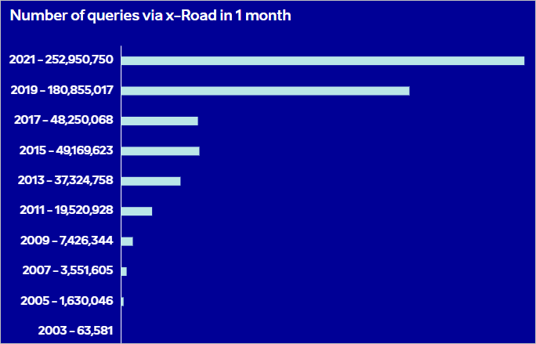
Number of queries via X-Road

Slide 16
Data Governance
From data to information

Slide 17
Summary of main challenges for the next decade
Strong data governance
Multiple-source data
High quality of statistics
High-quality indicators with metadata
Real-time information
Faster and simpler information
Reliable information
Quality data for media
Globalisation and Big Data
More in-depth information
User-friendly dissemination
Personalised view of information
Low administrative burden
Once-only principle in collection
Real-time data mining
Quick and quality decision-making

Slide 18


Prerequisites: data accessibility and quality
Four steps to ensure that data for decision-making is correct and relevant in terms of time and content:
Understand where and how data appear (metadata)
Establish data governance principles, data standards and data quality control
Administered data processing and anonymised sharing
Visualisation of indicators and dissemination with meta-information
50%
75%
85%
98%

Slide 19
Digital Agenda 2020 for Estonia (EIS)
Set by the Estonian government in 2013, reviewed 1 November 2018
Sub-objective: ICT solutions are used to enhance the functioning and management of public authorities by improving public sector capacity to use data analytics and data science, incl. respective awareness and skills.
Activity: Statistics Estonia will be transformed into public-sector competence centre for data governance and data science, which would support data-driven decision-making in the country, taking into account the systems supporting the state information system.

Slide 20
Data governance – new role for NSOs
State
Information System
Authority
DATA GOVERNANCE (DATA STEWARDS**)
Metadata
Life- cycle manage-ment
Data quality
Data architec-ture
Dissemi-nation
Data Protection Inspectorate
Personal data protection
Access to public data
Restricted information protection
Architecture of state information systems
State data and document exchange layers
State cyber security
State infrastructure
National Archives, etc.
Data archive
Source data of surveys

Slide 21
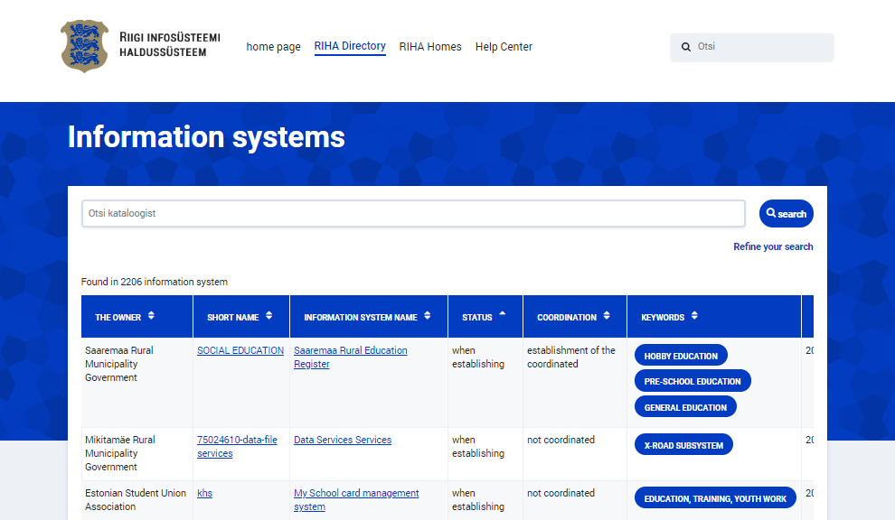
State Information System management (RIHA)
data
data
Harmonised
description
Services
metadata
data
metadata
Institution’s
data catalogue
RIHA 8.0
Open Data
Metadata enriched by Statistics Estonia
’
Institution’s
data
Statistics Estonia
Data lake
Statistics
data
data

Slide 22
Data Collection
From classical production to big data

Slide 23
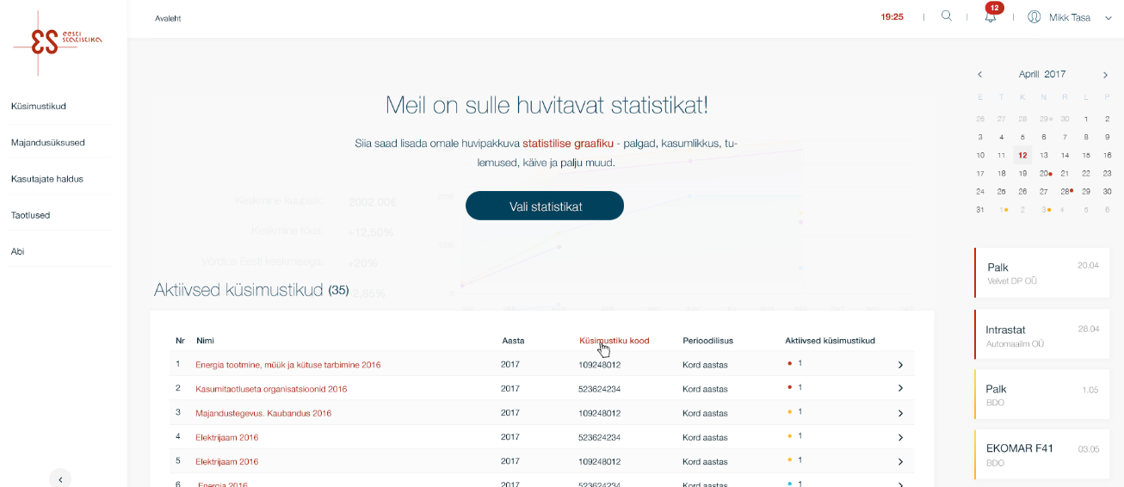
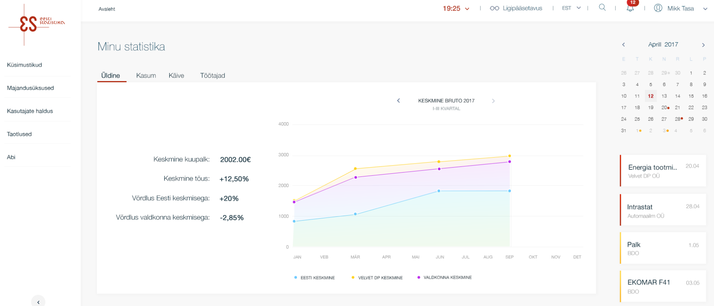
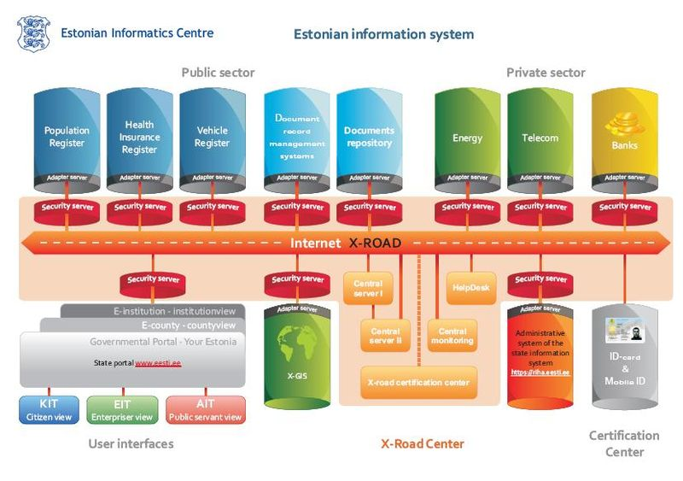
From classical surveys to machine-to-machine solutions
97% of surveys are done online
Voluntary Reporting 3.0
based on state ontology
XBRL
Cooperation between:
Estonian Tax Board
Bank of Estonia
Statistics Estonia
67% of the statistical activities use administrative data from more than 150 databases.

Slide 24
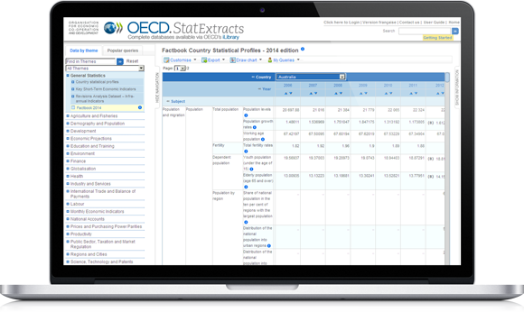
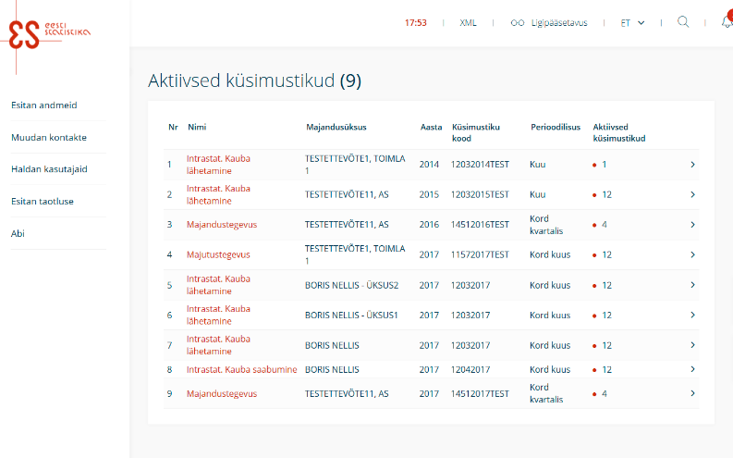
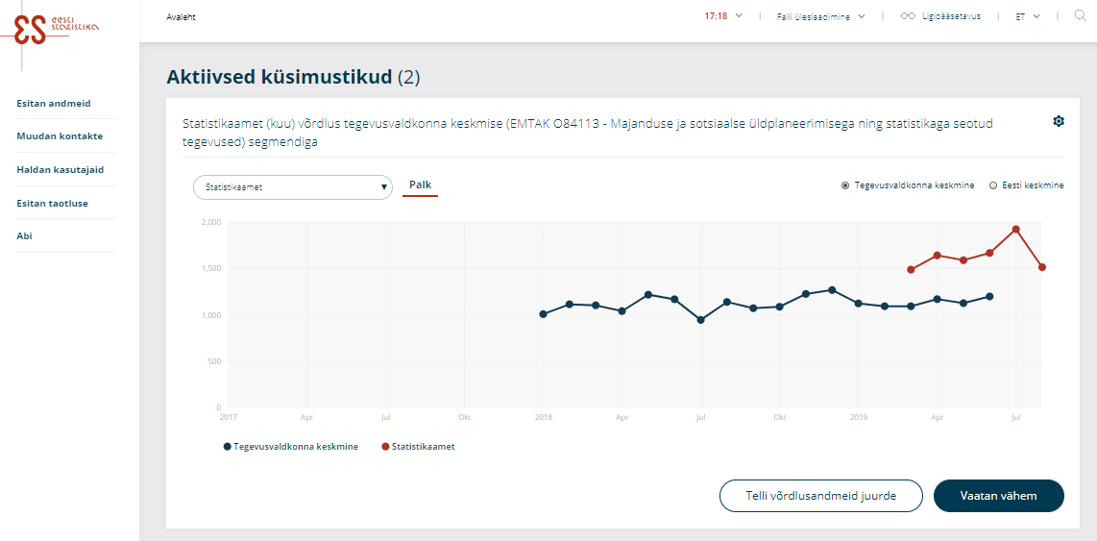
New collection tool: eSTAT
New visual
More intuitive movement in the system and questionnaires
More logical and clearer error messages
Questionnaires to be submitted are indicated more explicitly
Contact information easier to manage
Messages and reminders displayed in the system
Immediate feedback to respondents

Slide 25
Obligation to use administrative data
/…/ a producer of official statistics shall primarily use data collected in administrative records, data generated in the course of the activities of state and local government authorities and legal persons or collected by them, if such data allow the production of official statistics complying with the quality criteria of official statistics (OSA § 29(1))
A producer of official statistics has the right to make proposals for amending the composition of data and the classifications used in the administrative records and databases /…/ (OSA § 29(2))
A producer of official statistics has the right to link micro-data collected from respondents and administrative records and databases by using characteristics that allow direct or indirect identification of statistical units (OSA § 30(3))
At the request of a producer of official statistics, chief processors of databases shall submit the data collected in the administrative records and databases (OSA § 28(4))

Slide 26
Supported by Public Information Act
A database is established by an Act or legislation issued on the basis thereof. (§43³(1))
Before the establishment of a database or changing the composition of the data collected in a database, introducing a database or terminating a database, the technical documentation of the database shall be approved by the Estonian Information System's Authority, the Data Protection Inspectorate and the Statistics Estonia. (§43³(3))
Administration system for the state information system (RIHA) serves as a catalogue for the state’s information system https://www.ria.ee/administration-system-of-the-state-information-system

Slide 27
Examples
Statistical activity | Administrative data source
Forest resources | Estonian Environment Agency: area of forest and other wooded land and area of stands
Annual statistics of livestock farming | Estonian Agricultural Registers and Information Board (ARIB): number of cattle, sheep and goats by age-class
Construction of dwellings and non-residential buildings | Register of Construction Works: granted building permits (number and floor area of dwellings by county)
Social benefits | Ministry of Social Affairs: total funds used for subsistence benefits and for the provision and development of social benefits and services, etc.

Slide 28
Annual financial statements
Annual financial statements (AR) — the primary administrative source for annual business statistics. According to the Estonian Commercial Code all Estonian enterprises (excl. sole proprietors) are obliged to submit their annual financial statements to the Commercial Register 6 months after the end of the accounting year.
Starting from 1 January 2010, commercial undertakings, non-profit associations and foundations are obliged to provide their annual financial statements only electronically.
Starting from May 2010, Statistics Estonia started to receive annual financial statements data in XBRL format via X-Road (an environment that facilitates making queries to main state databases in Estonia).

Slide 29
Data Dissemination
From database to data science

Slide 30
Client segments and solutions
Researchers
(VIP users)
DATA VOLUME
Researchers’ solution
Key users (main
representatives of public interest)
.Stat database, GeoStat
Self-service dashboards
Dashboards
Open data
Media
Press releases
Main users (entrepreneurs, students)
Datasets
Publications
Infrequent users
Web applications
Infographics
NR OF CLIENTS
Social media

Slide 31
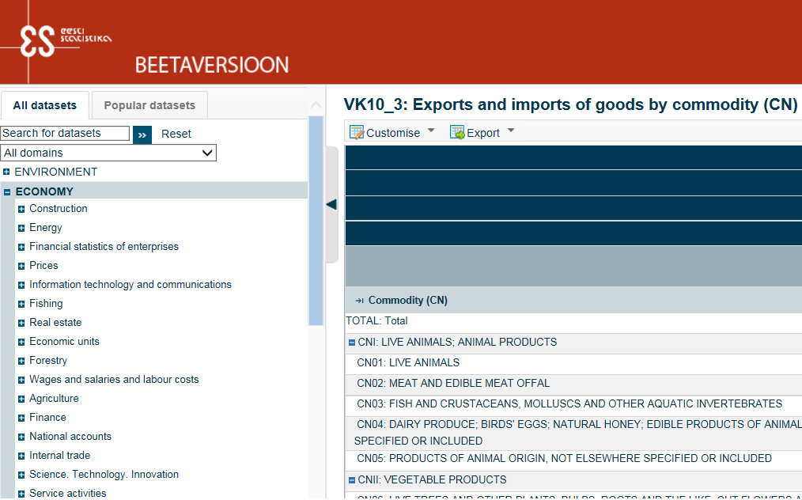
Publishing
The results of the statistical activities of Statistics Estonia are published in the Statistical Database.
Statistical data of interest to the public are announced in press releases.
All news and releases are subject to 0h principle: no stakeholders get information before the official release.
Currently 2 synchronised dissemination platforms:
  PX-Web (since April 2001) – primary
  .STAT (since November 2017) – beta
POPULATION - Population indicators and composition, events
SOCIAL LIFE - Culture, education, households, labour market, work-life quality, etc.
ECONOMY - Agriculture, construction, energy, finance, foreign trade, national accounts, wages and salaries and labour costs, etc.
ENVIRONMENT - Natural resources and their use, environmental accounts, state of environment, agri-environmental indicators, etc.
MULTIDOMAIN STATISTICS - Integration, sustainable development, youth monitoring

Slide 32
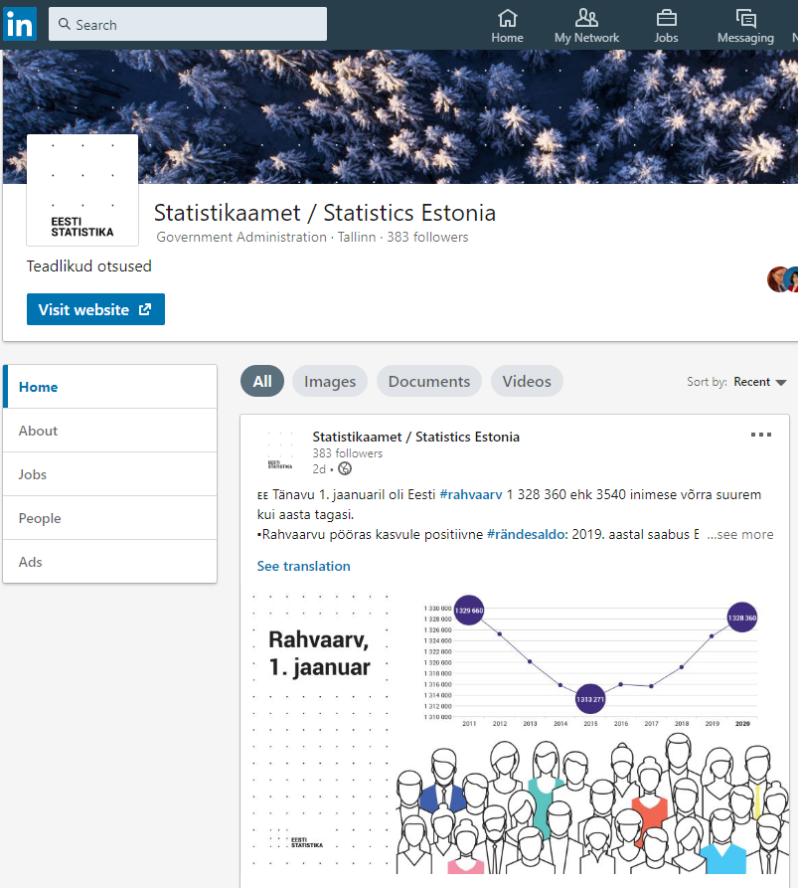

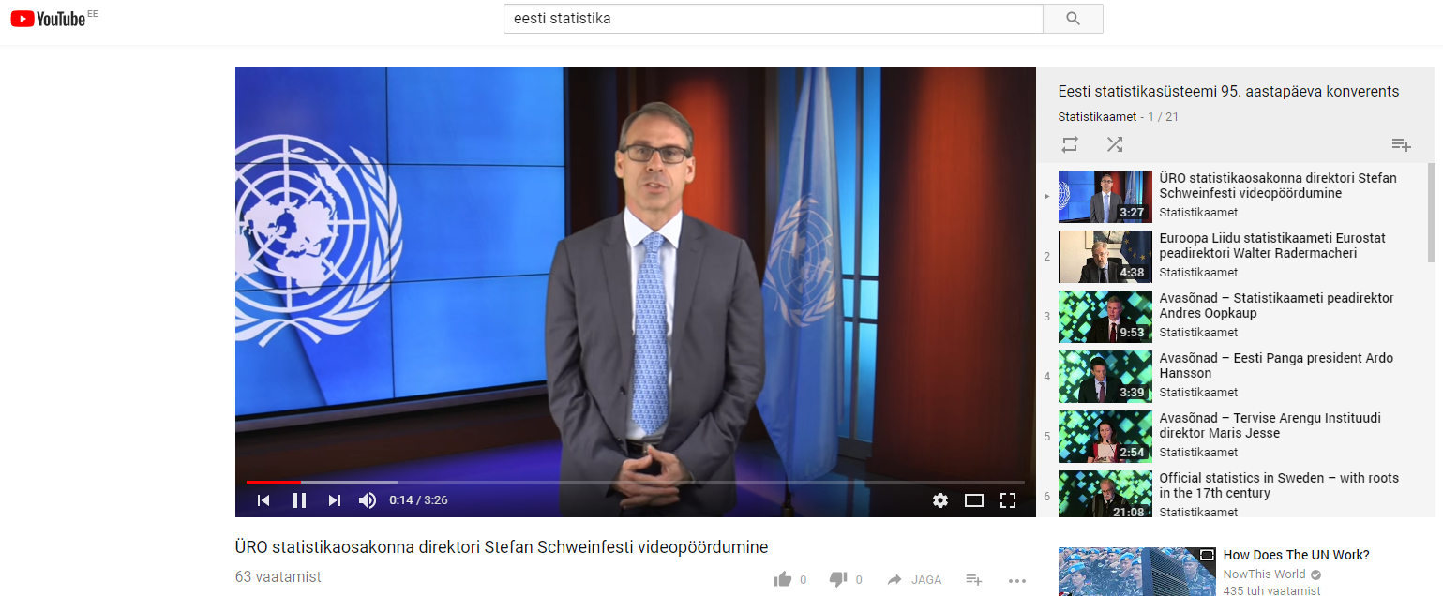
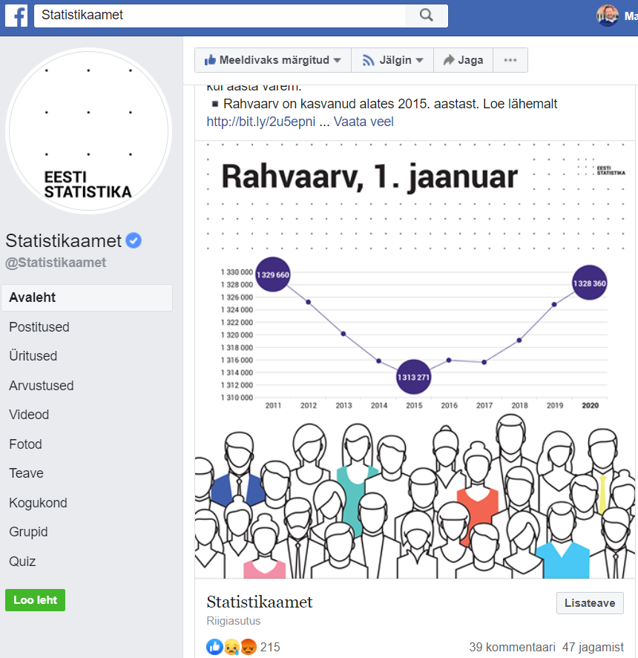
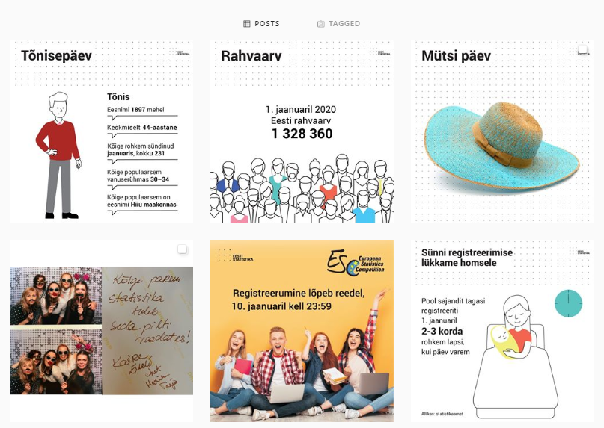
Social media (all major channels)

Slide 33
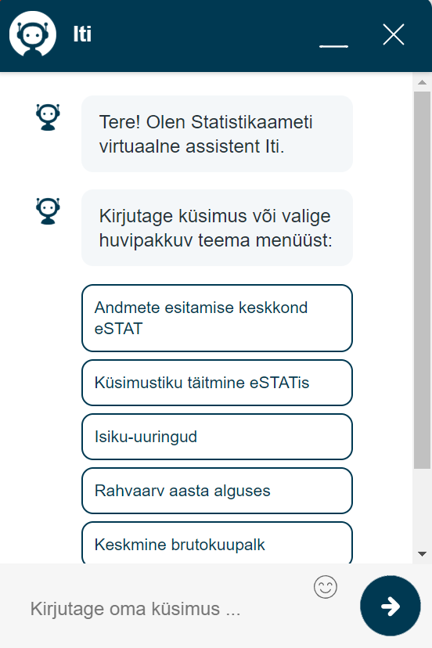
Automated requests and orders for information
Request for information provides data on published official statistics. The request for information is answered by e-mail, phone or chat.
Machine-learning chatbot (called Iti) gives answers based on the official statistical database.
Requests have doubled since the introduction of Iti, while only the number of e-mail requests has decreased.

Slide 34

Data visualisation and data science
Tallinn
New area of experimental statistics:
More real-time to spot critical areas
More community-centred to provide better life for citizens
More interlinked with public services
More visual and GIS-based
Developed in closer cooperation with universities, research organisations and communities
Sources:
Electricity metre data
Population register
Employment register
+ over 20 other registers

Slide 35
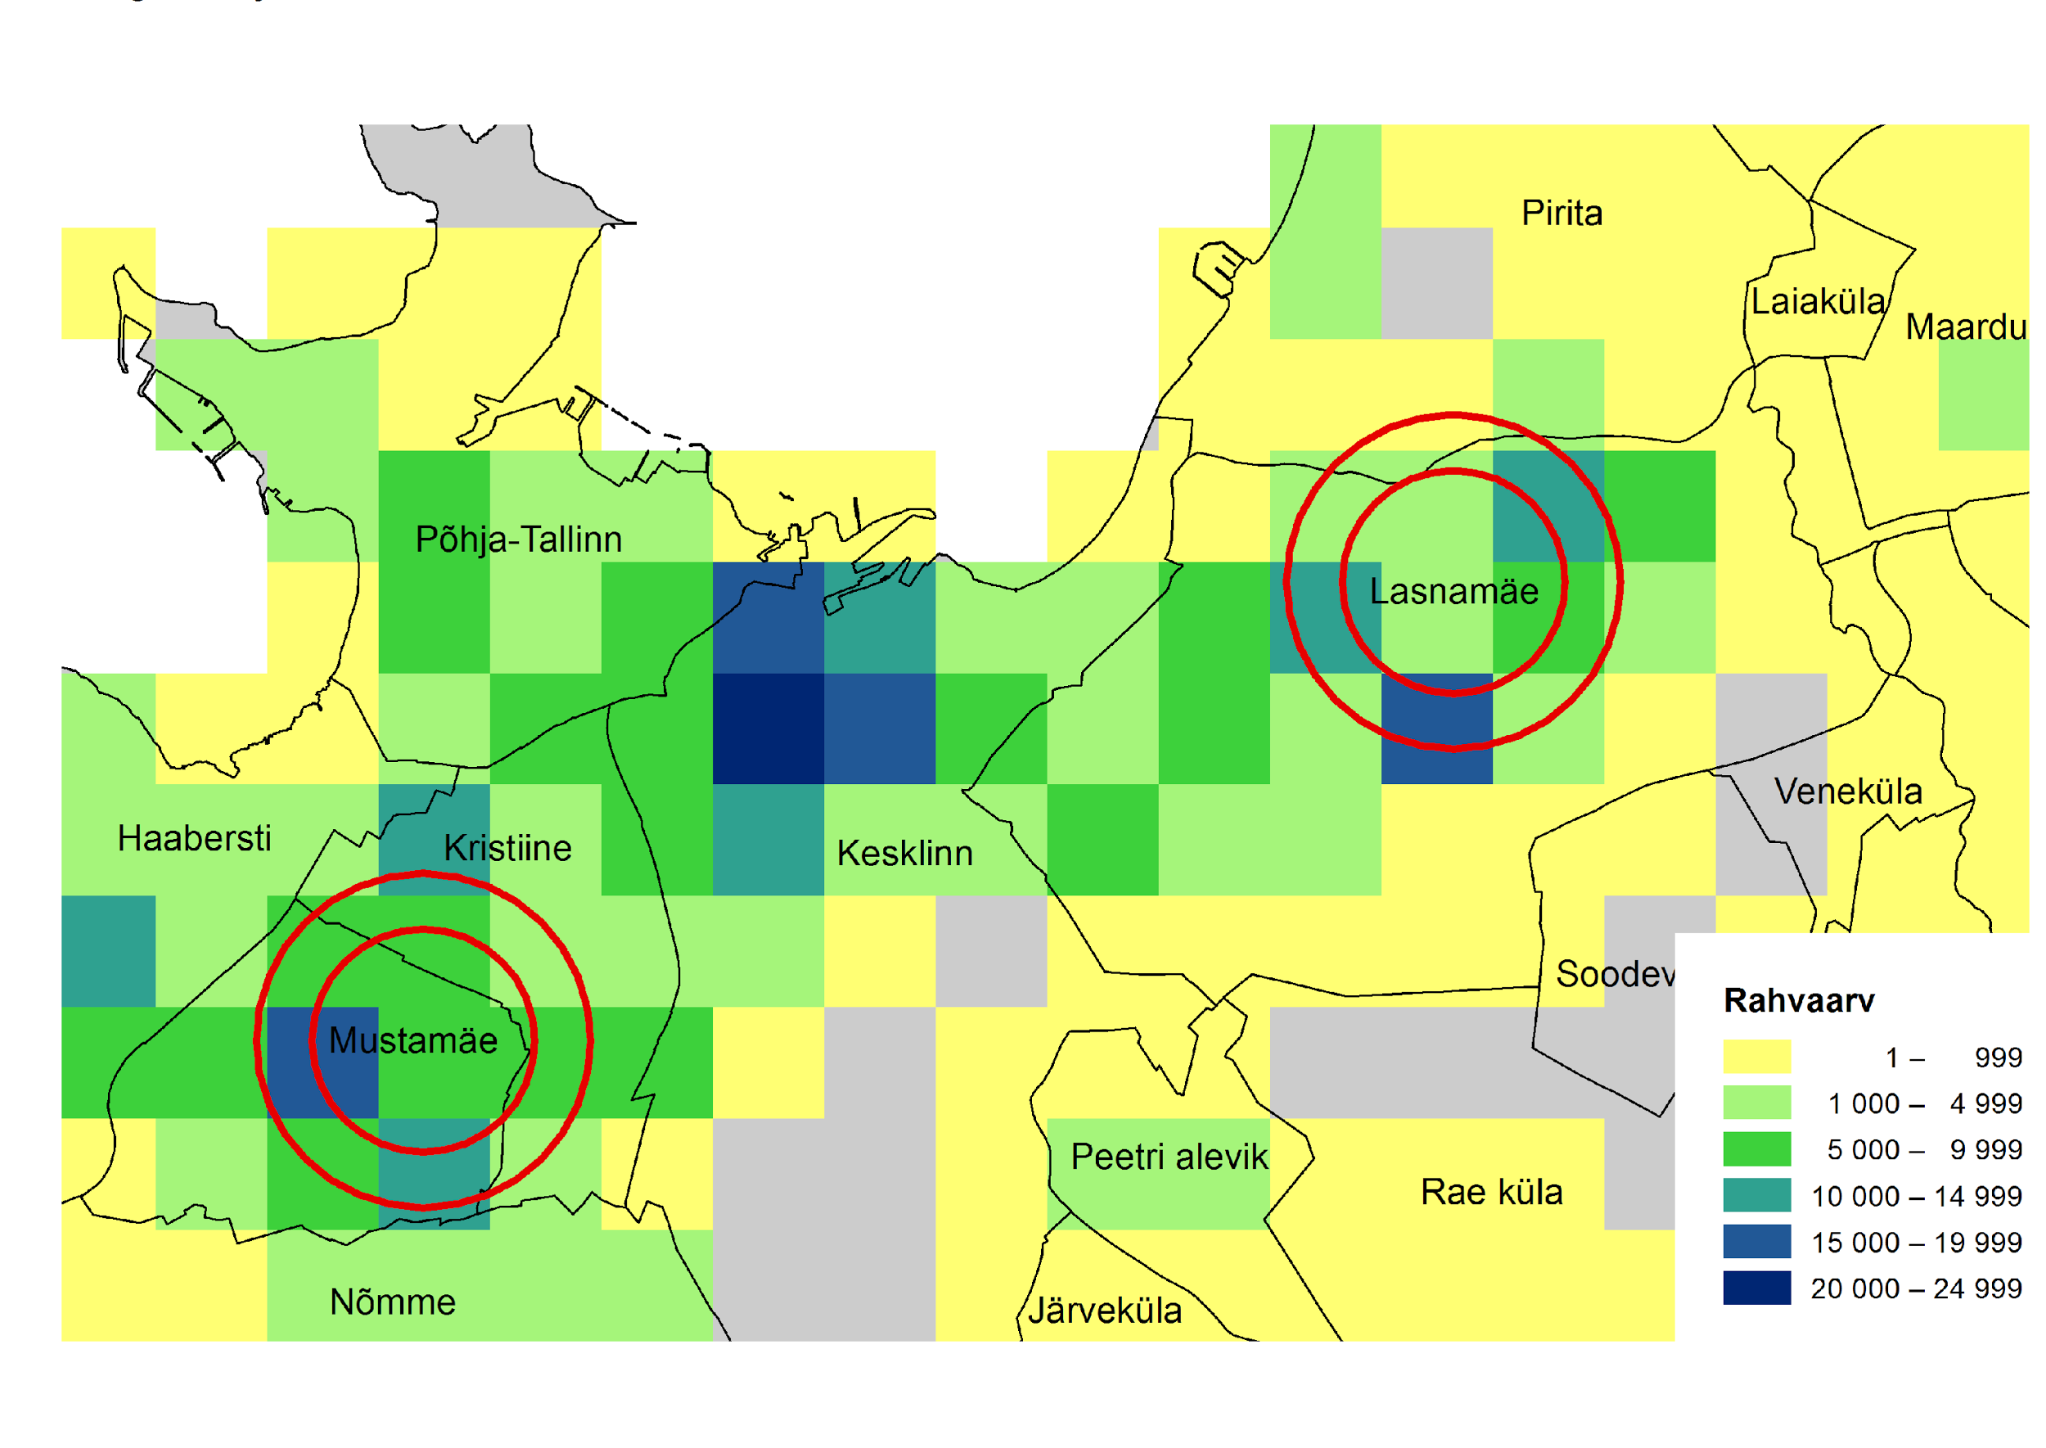
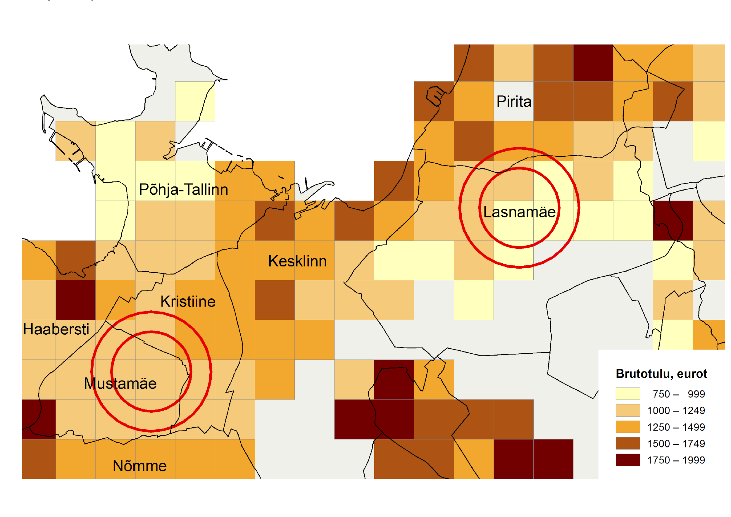
Example: Population and average income

Slide 36
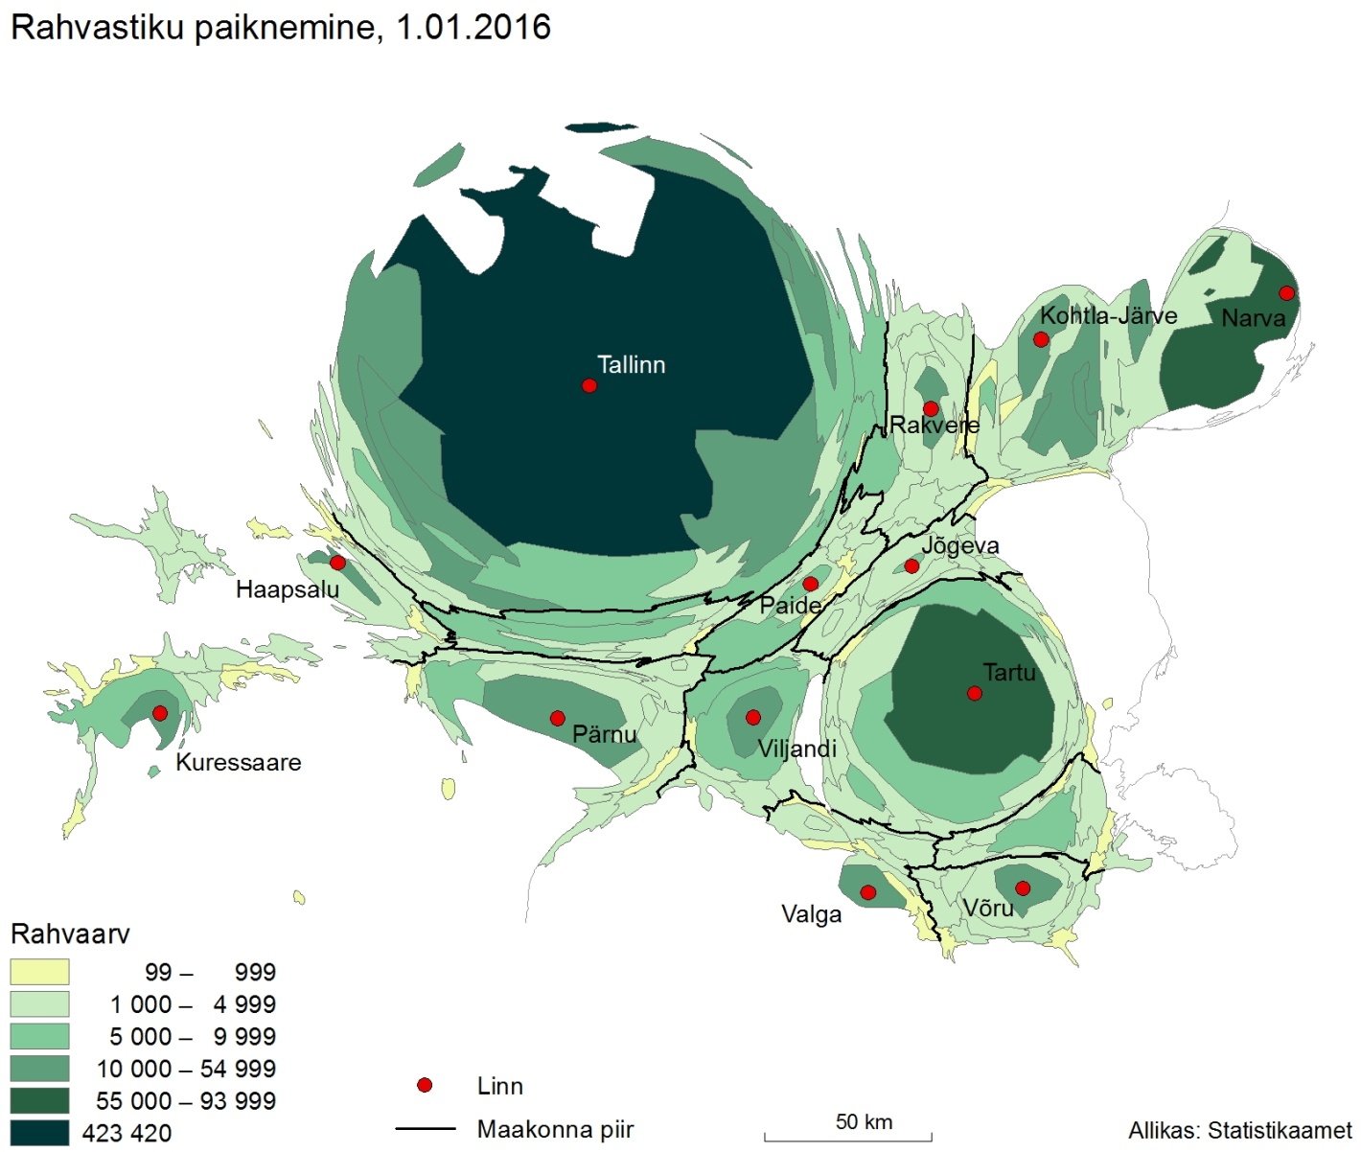
Population: Gastner-Newman method (ArcGIS)

Slide 37
Movement of secondary school students, 2016

Slide 38
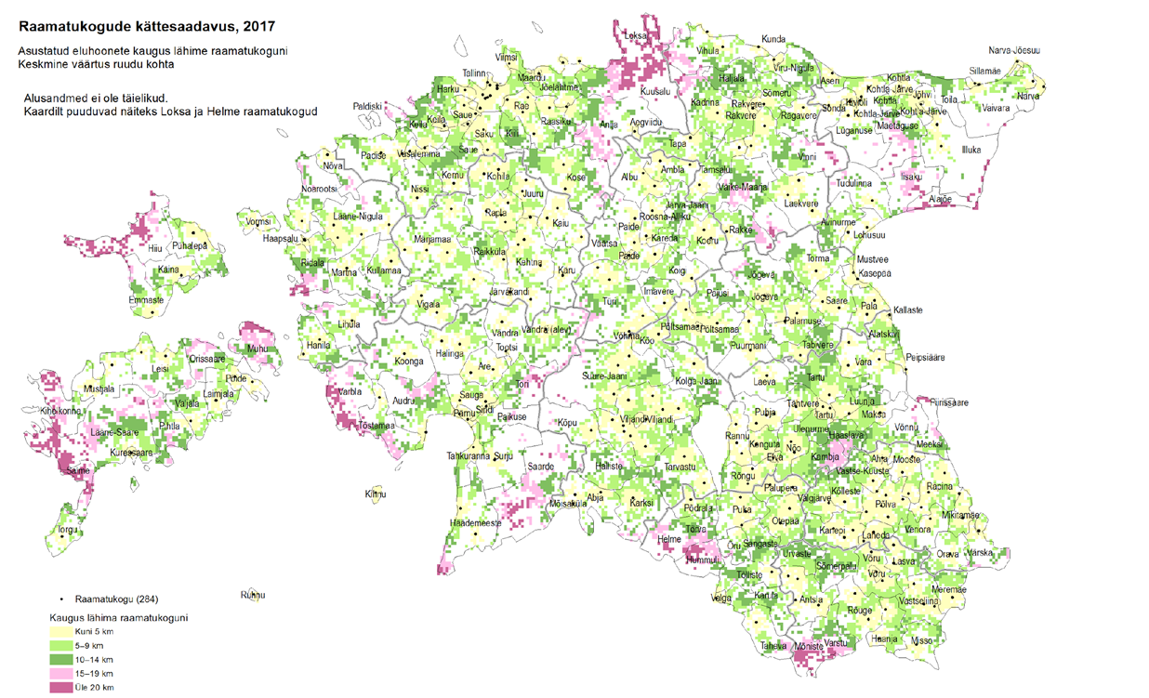
Availability of public libraries, 2017

Slide 39
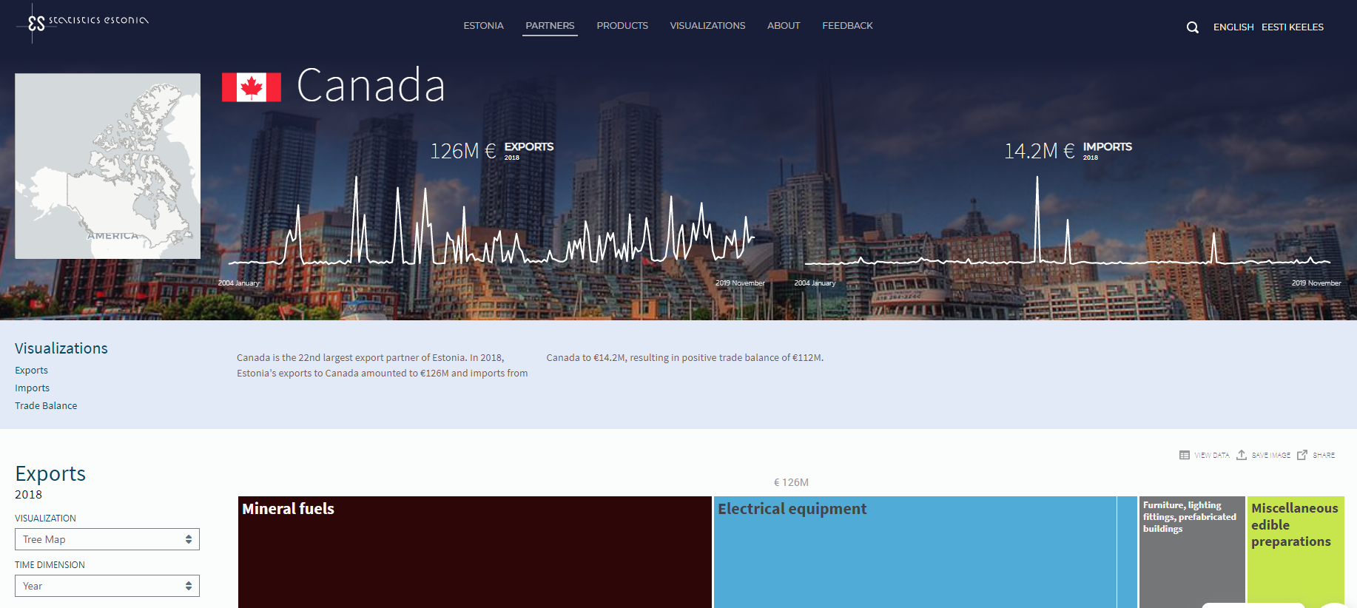
Foreign trade visualization app https://data.stat.ee/
* Max 90 days from the end of period to visual dissemination (monthly data)

Slide 40
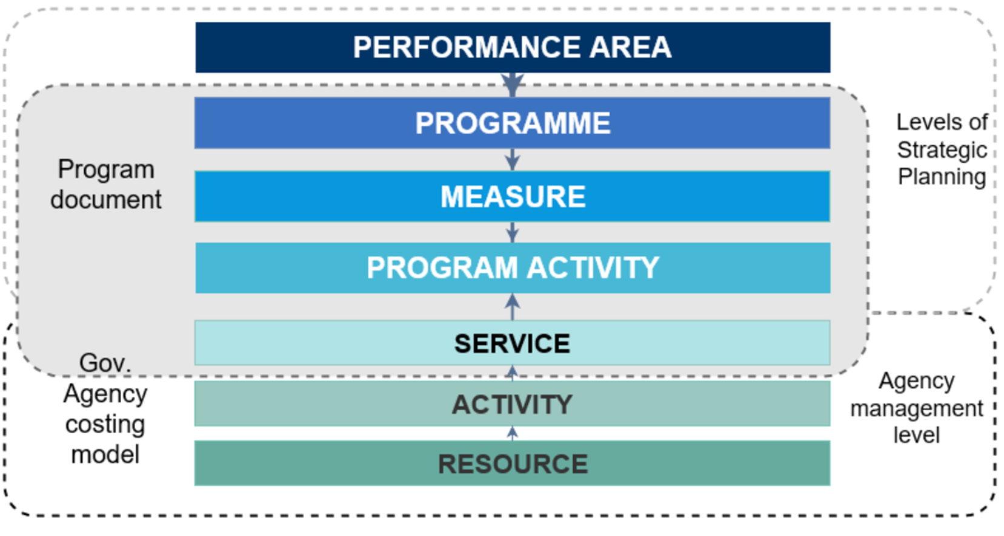
Strategic actions and performance-based budgeting
AREA
BUDGET/COSTING
IMPACT
INDICATORS
OUTCOME
INDICATORS
ACTIVITY BUDGET/COSTING
INPUT/ACTIVITY/ SERVICES INDICATORS
SERVICES BUDGET/COSTING

Slide 41
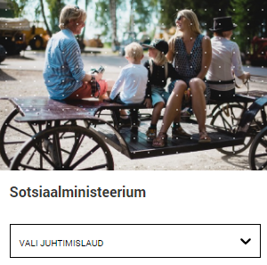

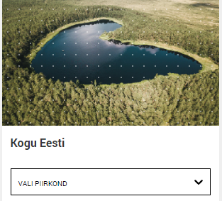
Same information in a personalised format
Critical
indicators
Statistics Estonia
Ministry dashboards
Government dashboard
ONA’s
Other registers
Other sources
Municipality
or trade unions dashboards

Slide 42
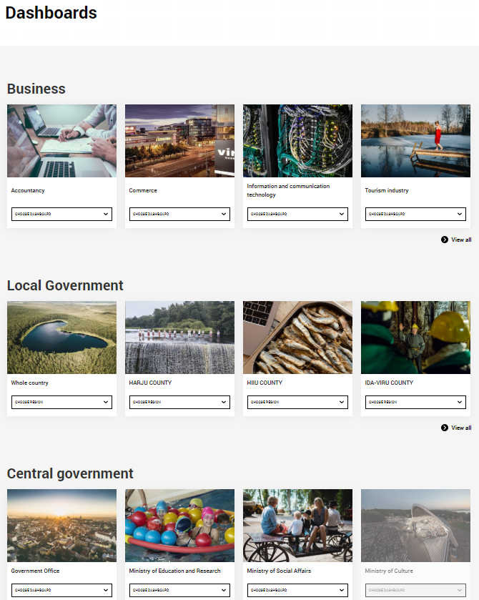
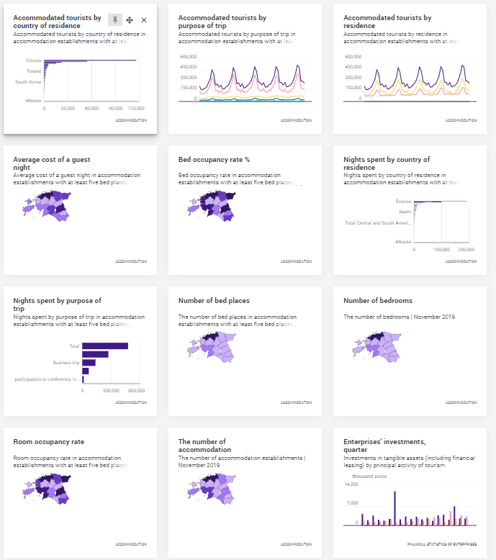
Dashboards https://juhtimislauad.stat.ee/
Key clients
Central goverment
Local goverment
Trade unions
Indicators:
incl. short explanation, source of information
Build your own dashboard

Slide 43

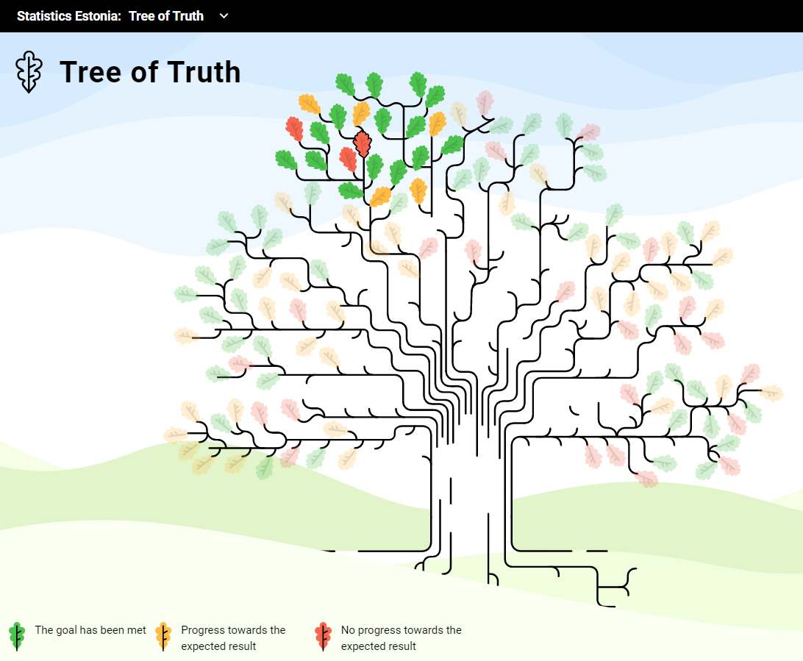
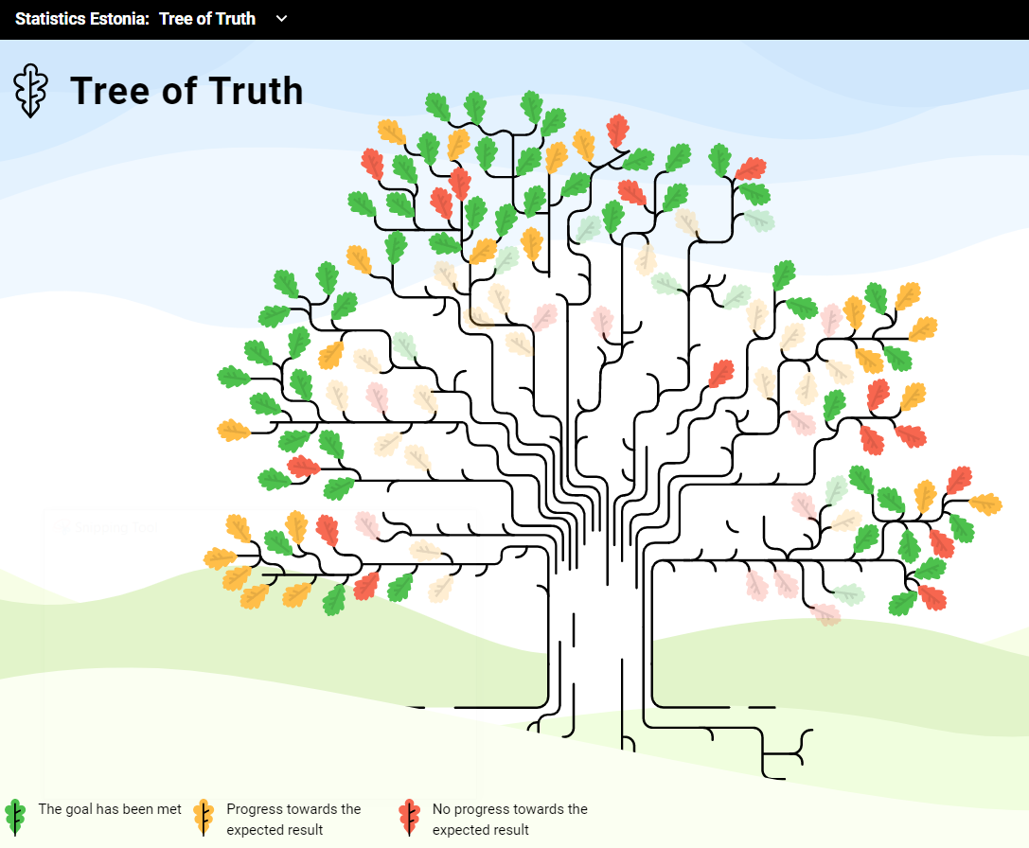
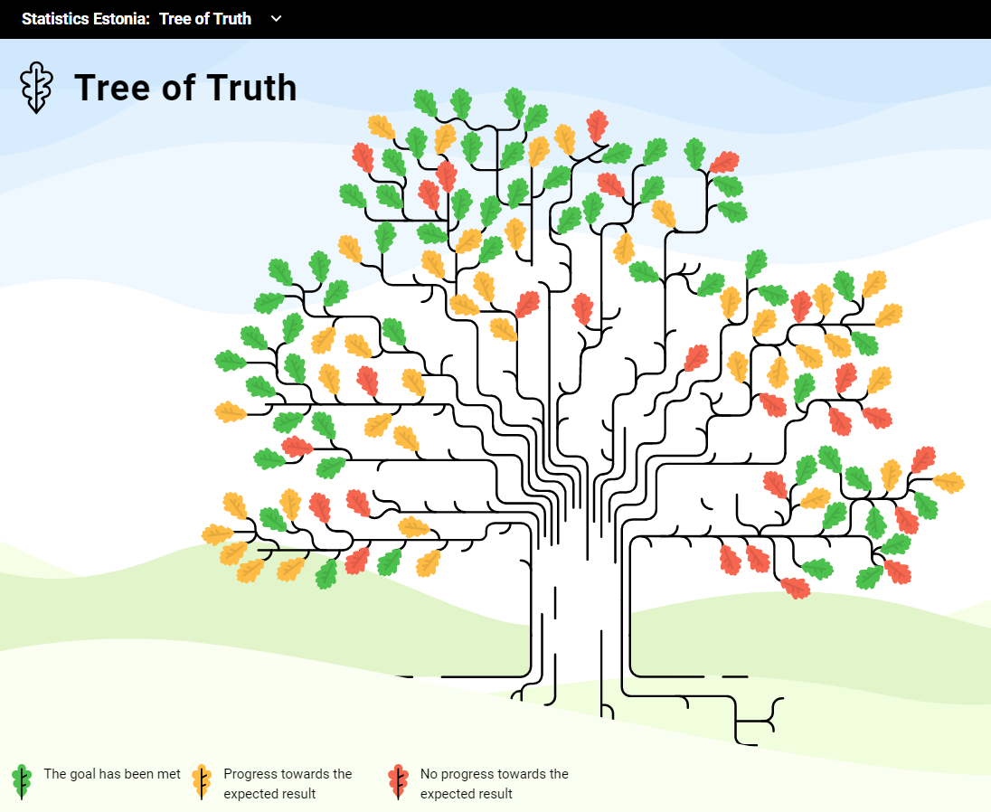
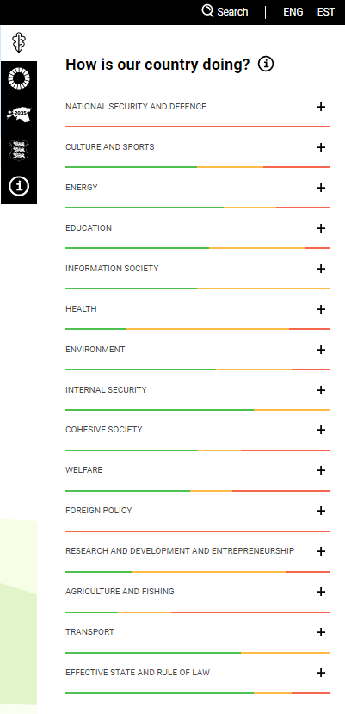
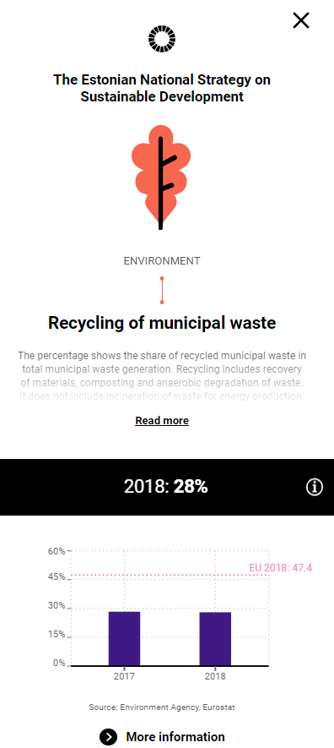
The Tree of Truth https://tamm.stat.ee/
Layers:
strategic plans
Branches:
performance areas
Leaves:
135 indicators incl. short explanation, current and target state with source of information

Slide 44
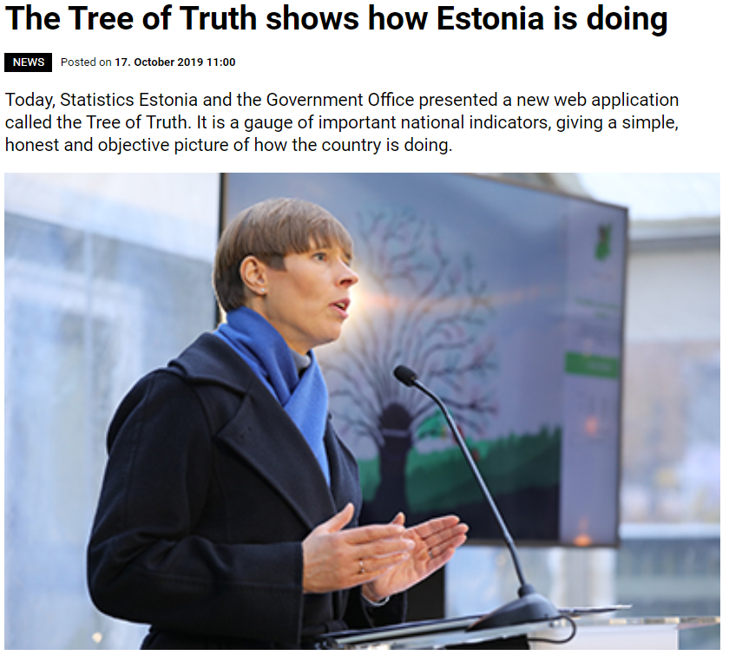
Statistics Day: celebrated every year on 20.10.2020
Major event of the period; opening speech was made by President of the Republic of Estonia
19,600 webpage visits during the first month
Chancellor of Justice presented Statistics Estonia with the national Clear Message Award 2020
Regular use at schools and
by the media
Refreshed look of the Tree of Truth revealed at the beginning of this year (4 January)
President of Estonia, Kersti Kaljulaid

Slide 45

Empowering
We do it for the citizens.
Simple approach
Strong media support

Slide 46

Thank you!
Questions?

